Slide 1
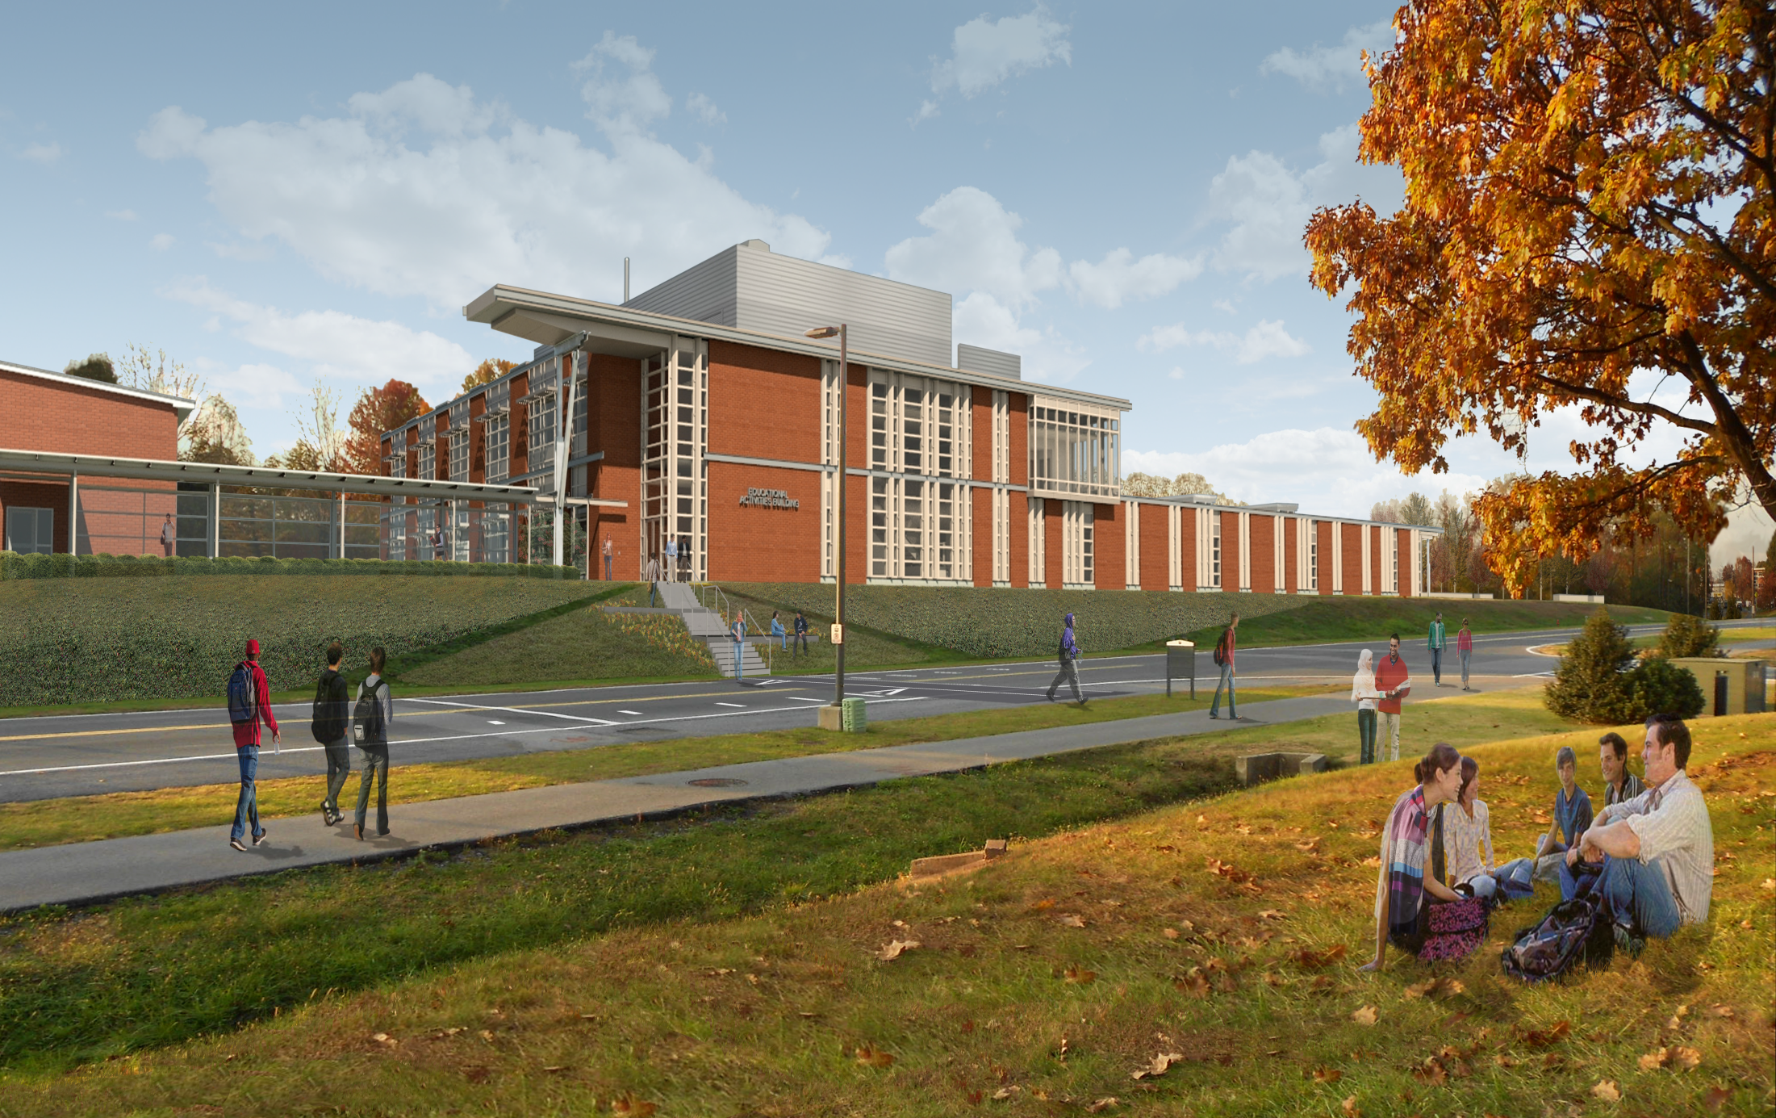
The Educational Activities Building
Penn State Harrisburg | Middletown, PA
Meshal Alenezi | Construction Management
Analysis 1: Green Roof System
Analysis 2: MEP Systems Prefabrication
Analysis 3: Structural Steel Sequencing
Analysis 4: Technology Integration for Information Management
Structural Breadth

Slide 2
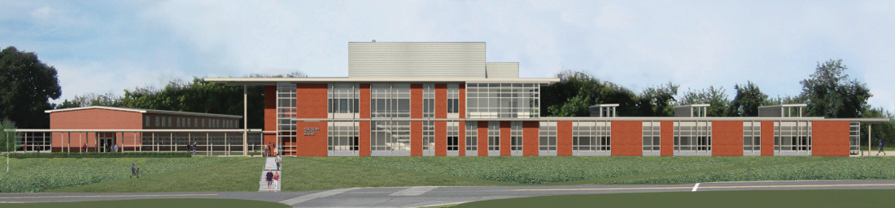
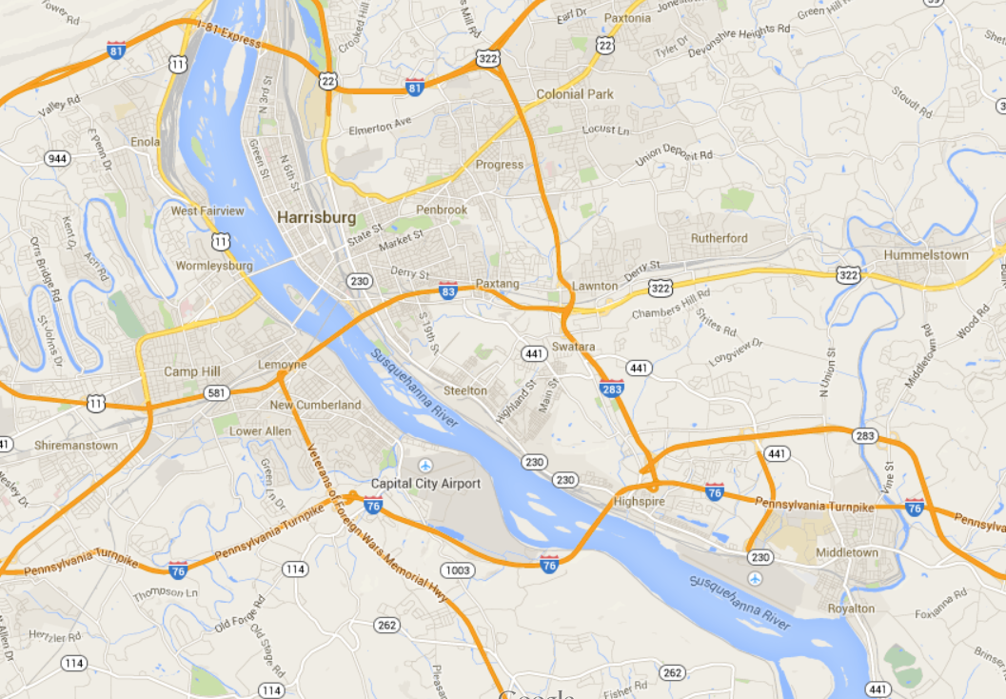
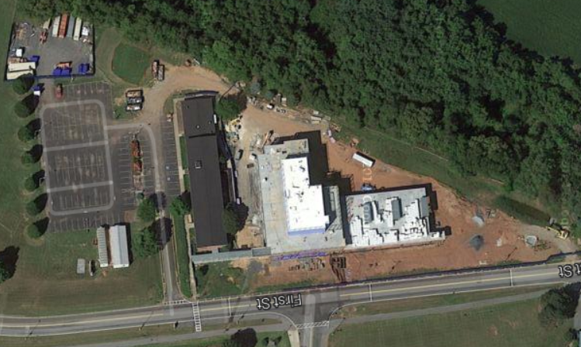

The Educational Activities Building
Penn State Harrisburg | Middletown, PA
Project Overview
Meshal Alenezi | Construction Management
Presentation Outline:
Project Overview
Analysis 1: Green Roof System
Analysis 2: MEP Systems Prefabrication
Analysis 3: Structural Steel Sequencing
Analysis 4: Technology Integration for Information Management
Conclusion & Recommendations
Acknowledgment
Questions
Owner | Penn State University
Location | Middletown, PA
Occupant Type | Business Group B
Size | 55,057 GSF
Height | 2 Stories and a Penthouse/ 48’
Project Cost | $19.4 Million
Construction Dates | Feb 2013- May 2014
Delivery Method | Design-Bid-Build
Contract Type | GMP
N
General Contractor
N
Harrisburg
Architect
Penn State Harrisburg Campus
Notes:
Contains engineering labs, classrooms, multi-purpose room, faculty research labs and computer labs.

Slide 3
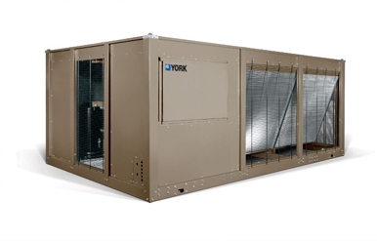
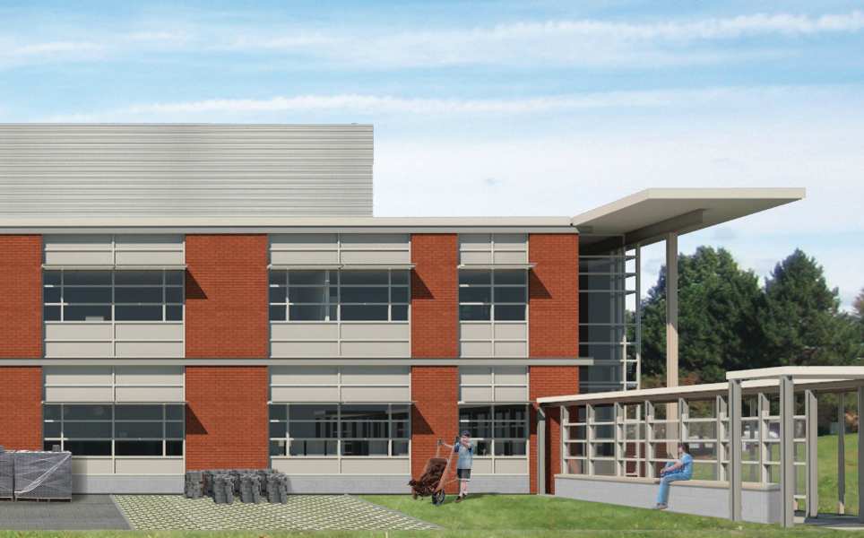
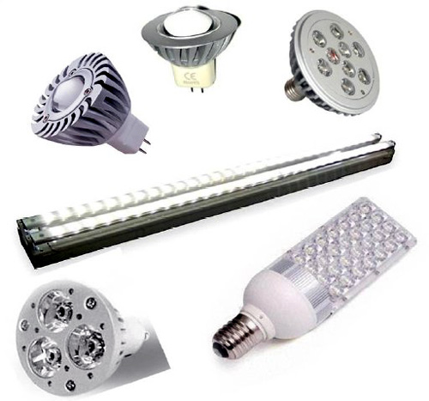
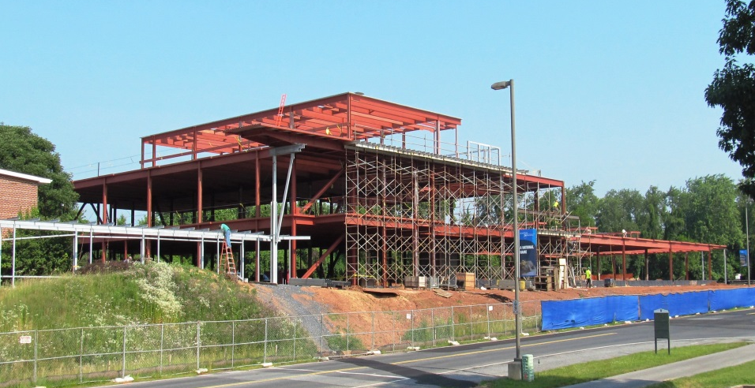
The Educational Activities Building
Penn State Harrisburg | Middletown, PA
Project Overview
Meshal Alenezi | Construction Management
Presentation Outline:
Project Overview
Analysis 1: Green Roof System
Analysis 2: MEP Systems Prefabrication
Analysis 3: Structural Steel Sequencing
Analysis 4: Technology Integration for Information Management
Conclusion & Recommendations
Acknowledgment
Questions
Mechanical System:
Central station air handling unit
Variable air flow distribution system
Chilled water for cooling and hot water for heating
Architecture:
Curtain walls & aluminum panels.
L-shaped building with a penthouse
Designed to be LEED certified
Connected to existing building by a pedestrian walkway connector
N
Central station air handling unit
Building Exterior
Electrical System:
40kW emergency generator
Majority of lighting is LED
Structural System:
Structural steel frame, mostly different sizes of wide flanges steel beam sand columns
Cast-in-Place Concrete for footings, foundation walls and slab-on-grade
LED Lighting Fixtures
Building Structural Frame

Slide 4
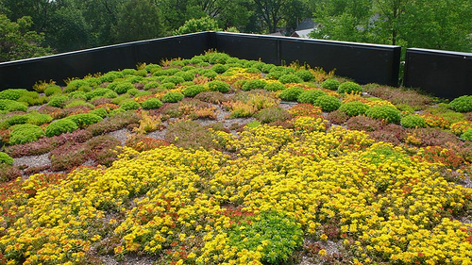
The Educational Activities Building
Penn State Harrisburg | Middletown, PA
Analysis 1: Green Roof System
Meshal Alenezi | Construction Management
Presentation Outline:
Project Overview
Analysis 1: Green Roof System
  Background
  Green Roof Evaluation
  Structural Breadth
  Results
Analysis 2: MEP Systems Prefabrication
Analysis 3: Structural Steel Sequencing
Analysis 4: Technology Integration For Information Management
Conclusion & Recommendations
Acknowledgment
Questions
Problem Statement
There is a potential to increase e the building value and performance with the addition of a green roof system.
Roof System:
1 ½“ Metal Deck
½“ Exterior Gypsum Sheathing
Air/Vapor Barrier
4” Rigid Insulation
½“ Gypsum Cover Board
Single Ply Membrane
The Proposed Design
Roof System Sectional View
Extensive Green Roof:
3-5 inches deep
15-25 lbs/ft²
Low maintenance
No irrigation required
Ideal for PV/Solar System integration
16,000 SF of Extensive Green Roof which covers about 60% of the total roof area
Extensive Green Roof System
Notes:
Type B 20 gauge galvanized metal roof deck and it is welded to the structural supporting members
covered with a 3.25 inches layer of light weight concrete with 6x6-W1.4XW1.4welded wire reinforcement.

Slide 5
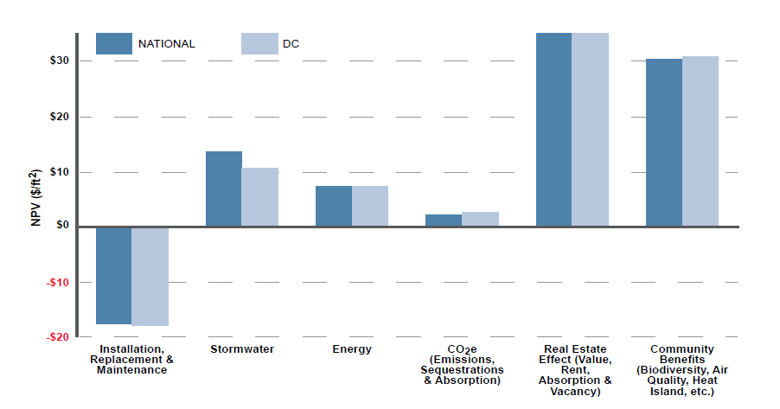
The Educational Activities Building
Penn State Harrisburg | Middletown, PA
Analysis 1: Green Roof System
Meshal Alenezi | Construction Management
Presentation Outline:
Project Overview
Analysis 1: Green Roof System
  Background
  Green Roof Evaluation
  Structural Breadth
  Results
Analysis 2: MEP Systems Prefabrication
Analysis 3: Structural Steel Sequencing
Analysis 4: Technology Integration For Information Management
Conclusion & Recommendations
Acknowledgment
Questions
Description | Quantity | Daily Output (SF) | Total Material Cost ($) | Total Labor Cost ($) | Total Cost ($)
4“ Green Roof System | 16,000 | 4,000 | 168,000 | 13,120 | 181,120
Constructability Review:
The roof will be built as designed
Pre-grown extensive vegetation trays delivery
Man power is used to place the trays
Loading (PSF) | Level 2 Roof and Penthouse Level Roof
Concrete Slab | 40
Metal Deck | 2
Additional ¾” Concrete | 8
M/E/C/L | 8
Membrane | 4
Insulation | 5
Beam/Grinder Self-Weight | 5
Green Roof Weight | 25
Total Dead Load | 97
Live Load (ASCE Table 4-1) | 100
Total Load | 197
Green Roof Cost Estimation
Dead and Live Loads
Pre-grown Extensive Vegetation Trays
Cost Benefit Analysis
Notes:
The installation productivity rate is 4000 SQFT per day with 4 laborers.

Slide 6
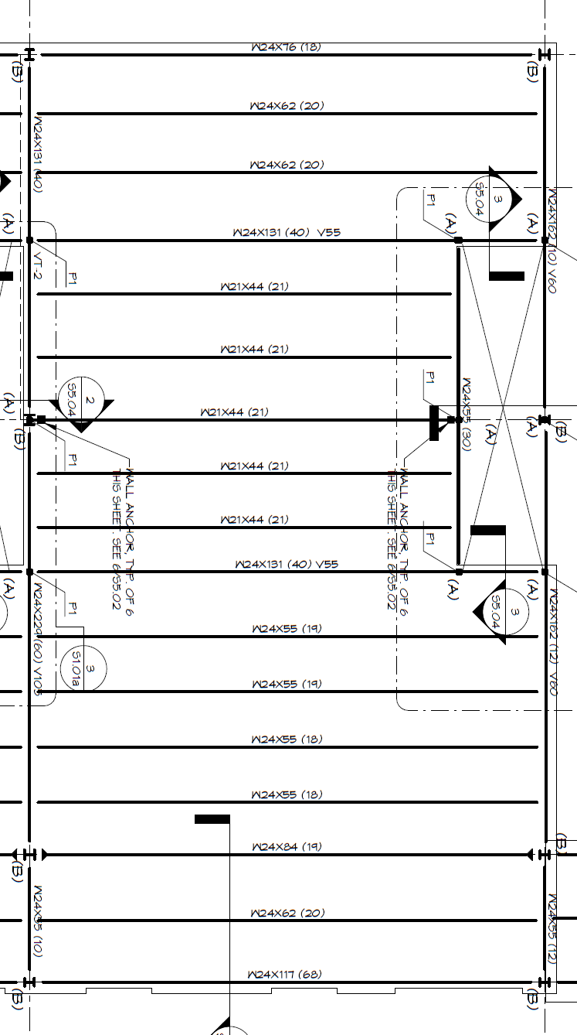

Analysis 1: Green Roof System
Structural Breadth
The Educational Activities Building
Penn State Harrisburg | Middletown, PA
Meshal Alenezi | Construction Management
Presentation Outline:
Project Overview
Analysis 1: Green Roof System
  Background
  Green Roof Evaluation
  Structural Breadth
  Results
Analysis 2: MEP Systems Prefabrication
Analysis 3: Structural Steel Sequencing
Analysis 4: Technology Integration For Information Management
Conclusion & Recommendations
Acknowledgment
Questions
Structural Analysis Equations
Live Load Reduction
L = $L_{o}[.25+ \frac{15}{\sqrt{K_{LL}A_{t}}}\text{]}$
Factored Distributed Load
W=(1.2)(D_{L})+(1.6)(L)
Factored Bending Moment
M_{u} = $\frac{{(w}_{u})(l^{2})}{8}$
Factored Shear
V_{u} = $\frac{{(w}_{u})(l)}{2}$
Type | Moment (k-ft) | Max. Moment (k-ft) | Shear (Kips) | Max. Shear (Kips) | Result
Beams
W21x44 | 256.06 | 358 | 25.99 | 217 | Passing
W24x55 | 334.17 | 503 | 30.04 | 252 | Passing
W24x62 | 334.17 | 574 | 30.04 | 306 | Passing
W24x76 | 334.17 | 750 | 30.04 | 315 | Passing
W24x84 | 334.17 | 840 | 30.04 | 340 | Passing
W24x117 | 334.17 | 1230 | 30.04 | 400 | Passing
W24x131 | 334.17 | 1390 | 30.04 | 444 | Passing
Grinder
W24x55 | 40.53 | 503 | 14.74 | 252 | Passing
W24x131 | 441.55 | 1390 | 56.07 | 444 | Passing
W24x162 (31.5 ft) | 441.55 | 1760 | 56.07 | 529 | Passing
W24x162 (37.5 ft) | 722.46 | 1760 | 77.06 | 529 | Passing
W24x229 | 722.46 | 2530 | 77.06 | 749 | Passing
Beams 5” spacing 0.C. | Grinders
38.5’ W21x44 44.5’ W24x55 44.5’ W24x62 44.5’ W24x76 44.5’ W24x84 44.5’ W24x117 44.5’ W24x131 | 11’ W24x55 31.5’ W24x131 31.5’ W24x162 37.5’ W24x162 37.5’ W24x229
Beams and Grinders
Typical Building Bay

Slide 7
The Educational Activities Building
Penn State Harrisburg | Middletown, PA
Analysis 1: Green Roof System
Meshal Alenezi | Construction Management
Presentation Outline:
Project Overview
Analysis 1: Green Roof System
  Background
  Green Roof Evaluation
  Structural Breadth
  Results
Analysis 2: MEP Systems Prefabrication
Analysis 3: Structural Steel Sequencing
Analysis 4: Technology Integration For Information Management
Conclusion & Recommendations
Acknowledgment
Questions
Cons
High Initial Cost, $181,120
4 Days Installation Process
Recommendation
Due to the initial high cost and low ROI, implementing this solution is not recommended.
Pros
Energy Savings
Increased Property Value
Noise Reduction
Better Stormwater Control
Extend Roof Membrane Lifespan

Slide 8
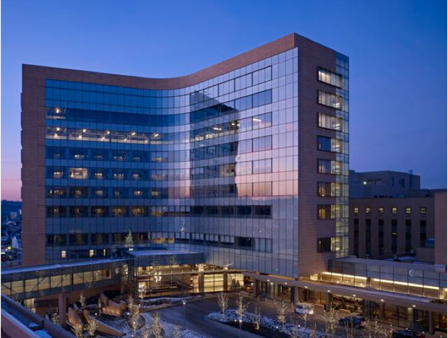
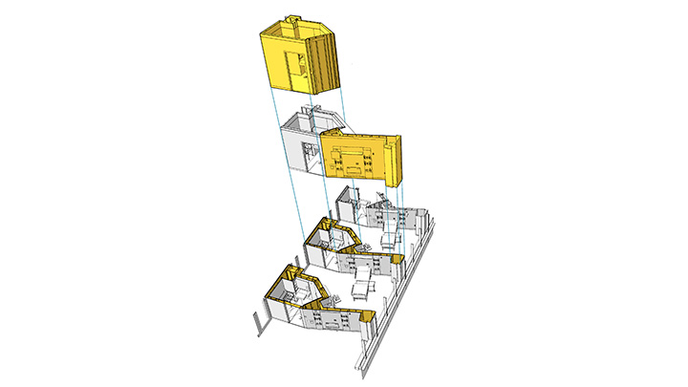
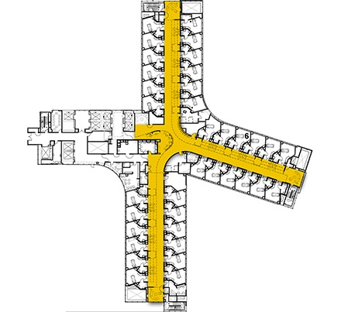
Analysis 2: MEP Systems Prefabrication
The Educational Activities Building
Penn State Harrisburg | Middletown, PA
Meshal Alenezi | Construction Management
Presentation Outline:
Project Overview
Analysis 1: Green Roof System
Analysis 2: MEP Systems Prefabrication
  Background
  Prefabrication Scope
  Constructability Review
  Schedule/Cost Evaluation
  Results
Analysis 3: Structural Steel Sequencing
Analysis 4: Technology Integration For Information Management
Conclusion & Recommendations
Acknowledgment
Questions
Problem Statement
The MEP systems activities overlap each other , which causes congestion on the construction site.
Case Study: Miami Valley Hospital Addition
178 Headwalls and Bathroom Pods.
120 Integrated MEP Corridor Racks
Productivity tripled
20% less Labor Cost
Reduced schedule by 2 months
Saved 1-2% of the project overall cost
Task | Start Date | Finish Date | Duration (Days)
Mechanical System | 7/17/2013 | 12/26/2013 | 117
Electrical System | 9/4/2013 | 12/24/2013 | 80
Plumbing System | 9/4/2013 | 1/9/2014 | 92
Original MEP Systems Schedule
Notes:
The worker were able to install 33 bathroom in an 8 hour work day to install 33 bathroom pods and 1.5 weeks to rough-in 30,000 S.F. pf patient floor.
For each corridor, there are two 8 ft. wide and 20 ft. long corridor integrated MEP racks that are placed side by side along the length of the corridor
This project witnessed the most ambitious implementation of multi-trade prefabrication in the US
Lessons:
The development of prefabrication should begin from the start to eliminate the need of any major design changes. Mr. Corrado stated that if the prefabrication decision had been made from day one, the schedule could have been reduced by 4 to 6 months.
Plan the prefabrication components production so they can be delivered to the construction site in time to avoid the need of any additional warehouses.
Collaboration between the different trades is an important factor for a successful multi-trade prefabrication. “We all had to buy into this process to make it work” says Mr. Fishking, a principle architect at NBBJ.
BIM is an important key to carry out multi-trade prefabrication; the 3D design helps with modeling the prefabrication parts.

Slide 9
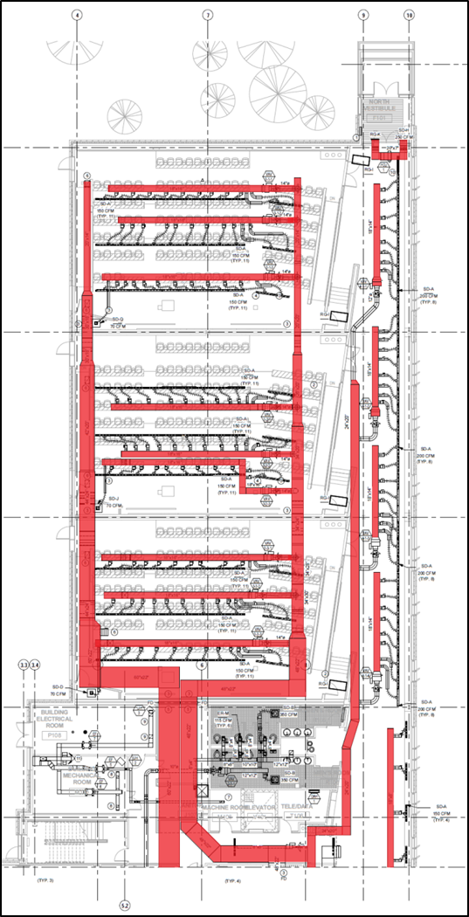
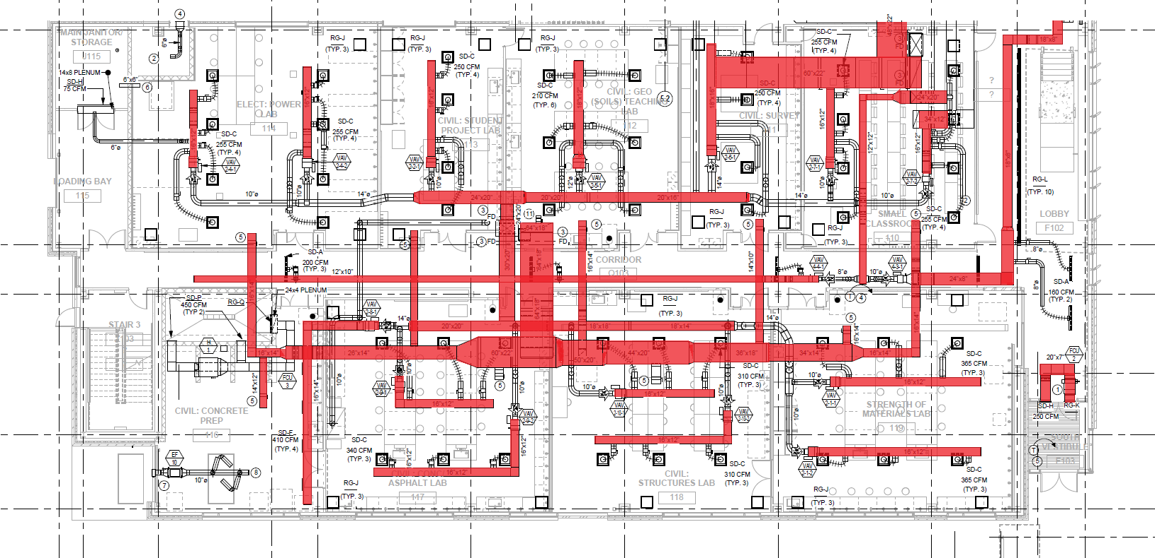
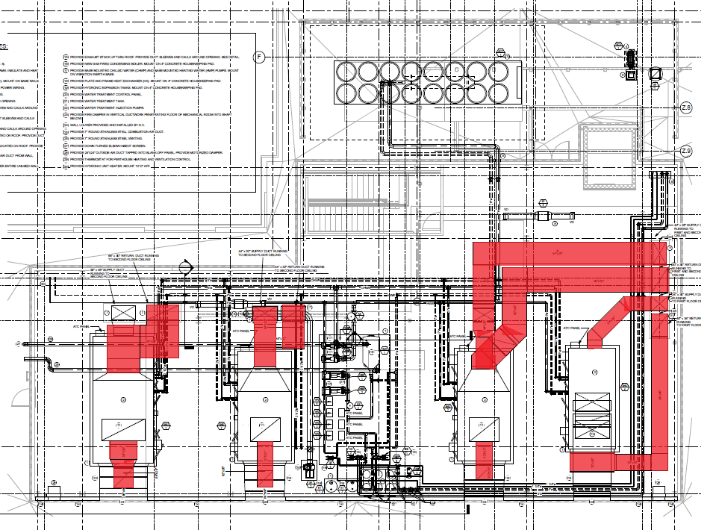
Analysis 2: MEP Systems Prefabrication
The Educational Activities Building
Penn State Harrisburg | Middletown, PA
Meshal Alenezi | Construction Management
Presentation Outline:
Project Overview
Analysis 1: Green Roof System
Analysis 2: MEP Systems Prefabrication
  Background
  Prefabrication Scope
  Constructability Review
  Schedule/Cost Evaluation
  Results
Analysis 3: Structural Steel Sequencing
Analysis 4: Technology Integration For Information Management
Conclusion & Recommendations
Acknowledgment
Questions
Mechanical System Scope
Only main Ductwork branches are considered for Prefabrication, sizes range from 12”x10” to 84”x24”
Electrical System Scope
Copper Conduit with a ½“ diameter or more
Cast Iron Pipes with 3” and 4” diameters
Plumbing System Scope
Copper Pipes type L with diameters between ½“ and 2 ½“
Cast Iron Pipes with 4” & 6” diameters
Black Steel Pipes with a 2” diameter
The main Ductwork branches that are considered for Prefabrication

Slide 10
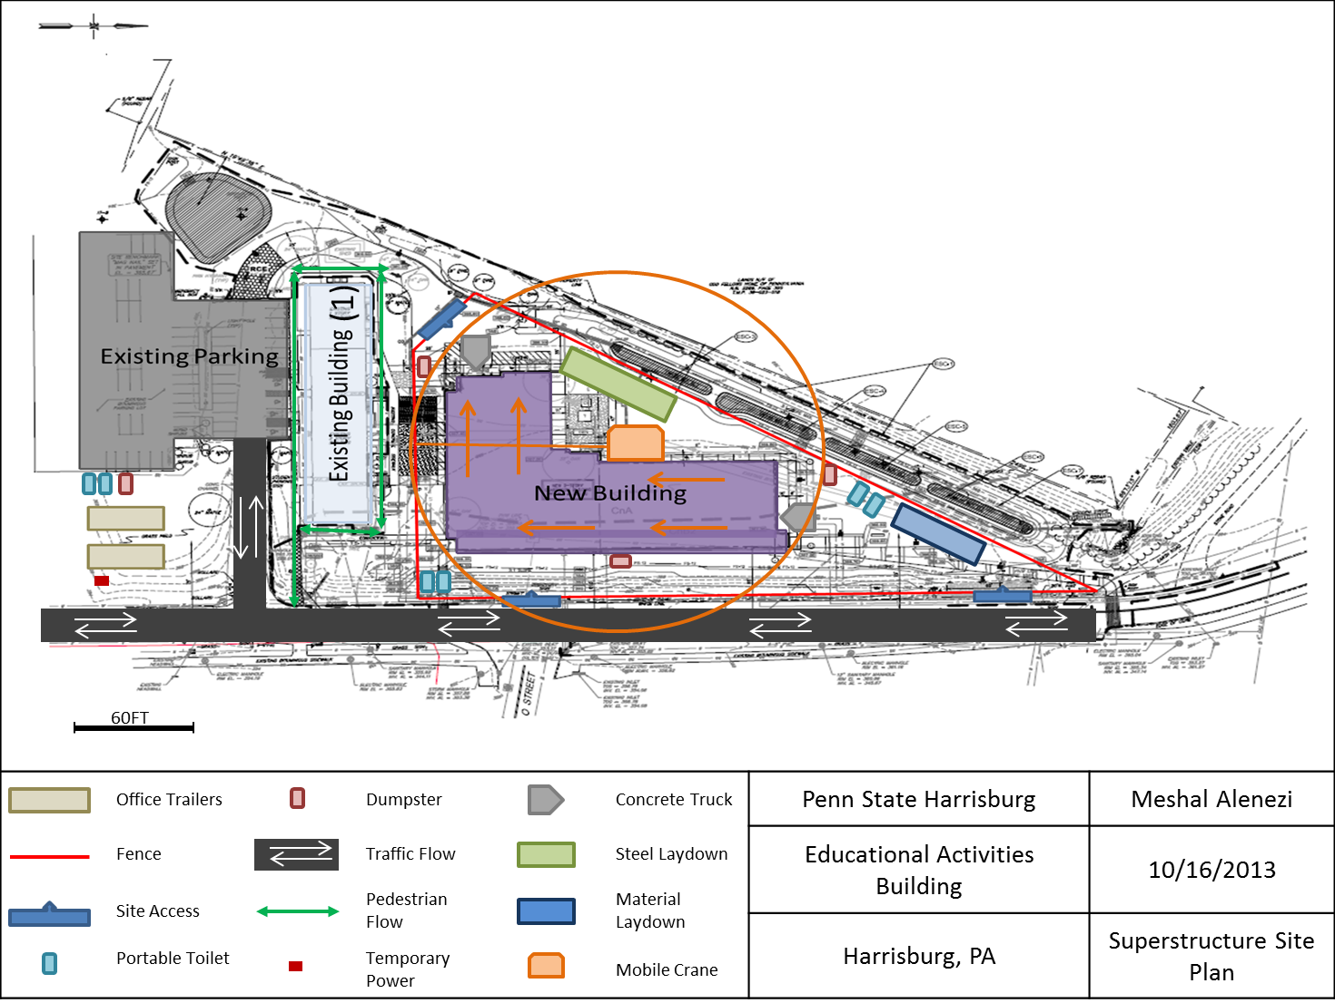
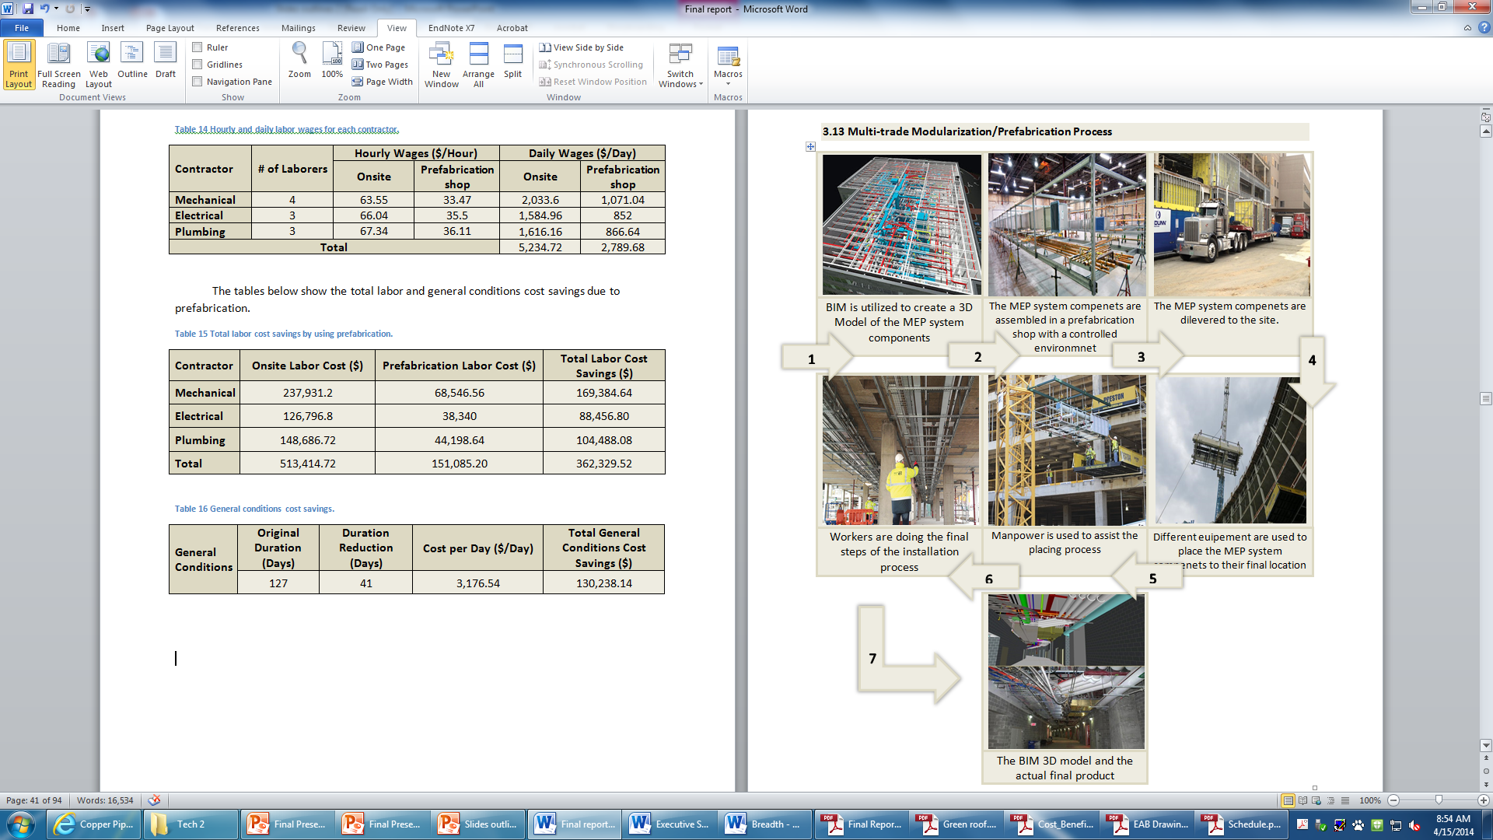
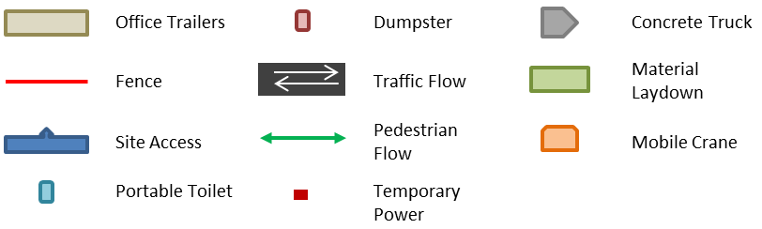
Analysis 2: MEP Systems Prefabrication
The Educational Activities Building
Penn State Harrisburg | Middletown, PA
Meshal Alenezi | Construction Management
Presentation Outline:
Project Overview
Analysis 1: Green Roof System
Analysis 2: MEP Systems Prefabrication
  Background
  Prefabrication Scope
  Constructability Review
  Schedule/Cost Evaluation
  Results
Analysis 3: Structural Steel Sequencing
Analysis 4: Technology Integration For Information Management
Conclusion & Recommendations
Acknowledgment
Questions
Construction Site Layout
Two Gates
Low Height
Material Laydown area
Mobile Crane
The Construction Site Layout
Notes:
Gates: One is located on the North East corner on First Street and the second access is located on the South West corner, which is reachable from First Street through a parking lot.
increases the feasibility of applying prefabrication because of the low height and the use of mobile crane.
As for the building exterior, which is usually built prior to the interior components, leaving openings is an ideal way for hoisting the MEP systems into the building. These openings could be sealed with temporary plastic sheets for weather protections and will be permanently closed when the MEP systems are put in place.

Slide 11
Analysis 2: MEP Systems Prefabrication
The Educational Activities Building
Penn State Harrisburg | Middletown, PA
Meshal Alenezi | Construction Management
Presentation Outline:
Project Overview
Analysis 1: Green Roof System
Analysis 2: MEP Systems Prefabrication
  Background
  Prefabrication Scope
  Constructability Review
  Schedule/Cost Evaluation
  Results
Analysis 3: Structural Steel Sequencing
Analysis 4: Technology Integration For Information Management
Conclusion & Recommendations
Acknowledgment
Questions
Contractor | Original Installation Duration (Days) | Prefabrication Installation Duration (Days) | Duration Reduction (Days)
Mechanical | 117 | 64 | 53
Electrical | 80 | 45 | 35
Plumbing | 92 | 51 | 41
Total | 127 | 86 | 41
 | Onsite Labor Cost ($) | Prefabrication Labor Cost ($) | Total Labor Cost Savings ($)
Mechanical | 237,931.2 | 68,546.56 | 169,384.64
Electrical | 126,796.8 | 38,340 | 88,456.80
Plumbing | 148,686.72 | 44,198.64 | 104,488.08
Crane Operator | -10,272.2 | - | -10,272.2
Crane | -23,220 | - | -23,220
Total | 479,922.52 | 151,085.20 | 328,837.32
Prefabrication productivity is double on-site productivity
Days Reduced for each Contractor and the Overall Project Schedule
Labor Cost Savings for each Contractor
Task | Start Date | Finish Date | Duration (Days)
Mechanical System | 7/17/2013 | 10/14/2013 | 64
Electrical System | 9/4/2013 | 11/5/2013 | 45
Plumbing System | 9/4/2013 | 11/13/2013 | 51
General Conditions | Original Duration (Days) | Duration Reduction (Days) | Cost per Day ($/Day) | Total General Conditions Cost Savings ($)
 | 127 | 41 | 3,176.54 | 130,238.14
New MEP Systems Schedule
General Conditions Cost Savings
Notes:
the prefabrication productivity rate is assumed to be double the site productivity for the Educational Activities Building project. This was productivity rate was assumed as an average which yields in cutting the duration by half with an addition of 5 days just in case of any extra work that needs to be done.
Number of worker for each contractor were obtained from the project team. 4M, 3E and 3P for installation
The cost of on-site workers were obtained from the project team, while the prefabrication were obtained from companies data.
Crane Cost $270 per day or $8100 per month.
Crane Operator Cost $119.4 per day or $3582 per month.

Slide 12
Analysis 2: MEP Systems Prefabrication
The Educational Activities Building
Penn State Harrisburg | Middletown, PA
Meshal Alenezi | Construction Management
Presentation Outline:
Project Overview
Analysis 1: Green Roof System
Analysis 2: MEP Systems Prefabrication
  Background
  Prefabrication Scope
  Constructability Review
  Schedule/Cost Evaluation
  Results
Analysis 3: Structural Steel Sequencing
Analysis 4: Technology Integration For Information Management
Conclusion & Recommendations
Acknowledgment
Questions
Cons
Requires Early Coordination between the MEP Systems Teams
Using Cranes for Additional Days
Recommendation
Due to the cost savings of $459075.46 and 41 Days schedule Reduction, the implementation of the solution is recommended.
Pros
Less Site Congestion
Schedule Reduced by 41 Days
$328,837.32 Labor Cost Savings
$130,238.14 General Conditions Savings

Slide 13
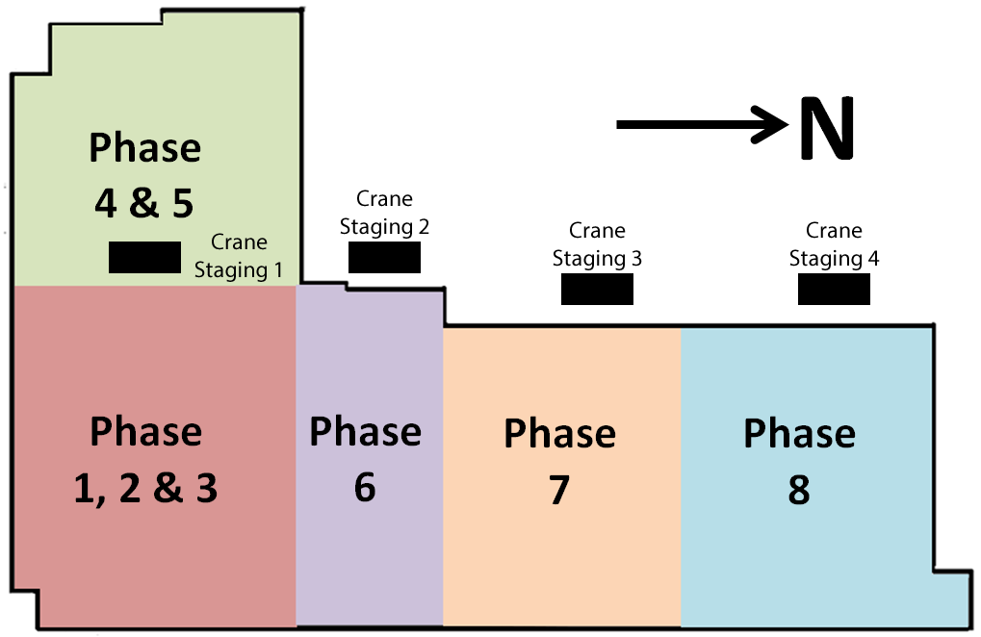
Analysis 3: Structural Steel Sequencing
The Educational Activities Building
Penn State Harrisburg | Middletown, PA
Meshal Alenezi | Construction Management
Presentation Outline:
Project Overview
Analysis 1: Green Roof System
Analysis 2: MEP Systems Prefabrication
Analysis 3: Structural Steel Sequencing
  Current Steel Sequence
  Crane Selection
  Proposed Steel Sequence
  Results
Analysis 4: Technology Integration For Information Management
Conclusion & Recommendations
Acknowledgment
Questions
Problem Statement
The structural steel erection is a critical path item, but there is a potential to improve the sequence and accelerate the schedule.
General Site Information
94,050 SF. construction site
First Street is the only main road adjacent to the Site
An exciting building is located South of the project
Material laydown area is located West of the North Wing
Steel Sequence Planning Considerations
Crane Type and Size
Crane Locations
Material Laydown Area
Steel Deliveries
The Current Steel Sequence and Crane Staging
Notes:
First Street is the only main road adjacent to the Site on the East.
Minimize the number of crane locations
Located the material laydown area within the crane reach at all time
3 deliveries to avoid any delays

Slide 14
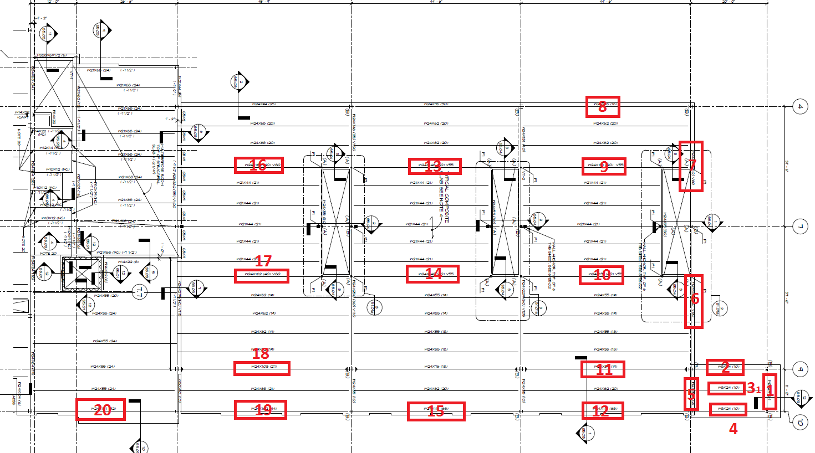
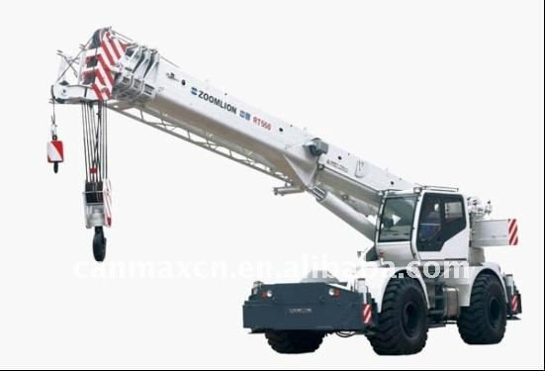
Analysis 3: Structural Steel Sequencing
The Educational Activities Building
Penn State Harrisburg | Middletown, PA
Meshal Alenezi | Construction Management
Presentation Outline:
Project Overview
Analysis 1: Green Roof System
Analysis 2: MEP Systems Prefabrication
Analysis 3: Structural Steel Sequencing
  Current Steel Sequence
  Crane Selection
  Proposed Steel Sequence
  Results
Analysis 4: Technology Integration For Information Management
Conclusion & Recommendations
Acknowledgment
Questions
Crane Selected
Rough Terrain Hydraulic Crane
50 Ton Capacity
110 Boom
Beam # | Beam Size | Beam Length (ft) | Beam Weight (lb) | Distance from Crane | Safety Check
Beam 1 | W8x24 | 11 | 264 | 90 | Passes
Beam 2, 3 & 4 | W8x24 | 20 | 480 | 90 | Passes
Beam 5 | W24x55 | 11 | 605 | 85 | Passes
Beam 6 | W24x162 | 37.5 | 6,075 | 80 | Passes
Beam 7 | W24x162 | 44.5 | 5,103 | 75 | Passes
Beam 8 | W24x76 | 44..5 | 3,382 | 60 | Passes
Beam 9 & 10 | W24x131 | 44.5 | 5,829.5 | 65-75 | Passes
Beam 11 | W24x84 | 44.5 | 3,783 | 80 | Passes
Beam 12 | W24x117 | 44.5 | 5,206 | 85 | Passes
Beam 13 & 14 | W24x146 | 44.5 | 6,497 | 30-40 | Passes
Beam 15 | W24x117 | 44.5 | 5,206 | 60 | Passes
Beam 16, 17 & 19 | W24x162 | 45.75 | 7,411 | 30-60 | Passes
Beam 18 | W24x103 | 45.75 | 4,712 | 50 | Passes
Beam 20 | W24x131 | 38.5 | 5,043 | 70 | Passes
Hydraulic Crane
The Critical Beams Location of the North Wing

Slide 15
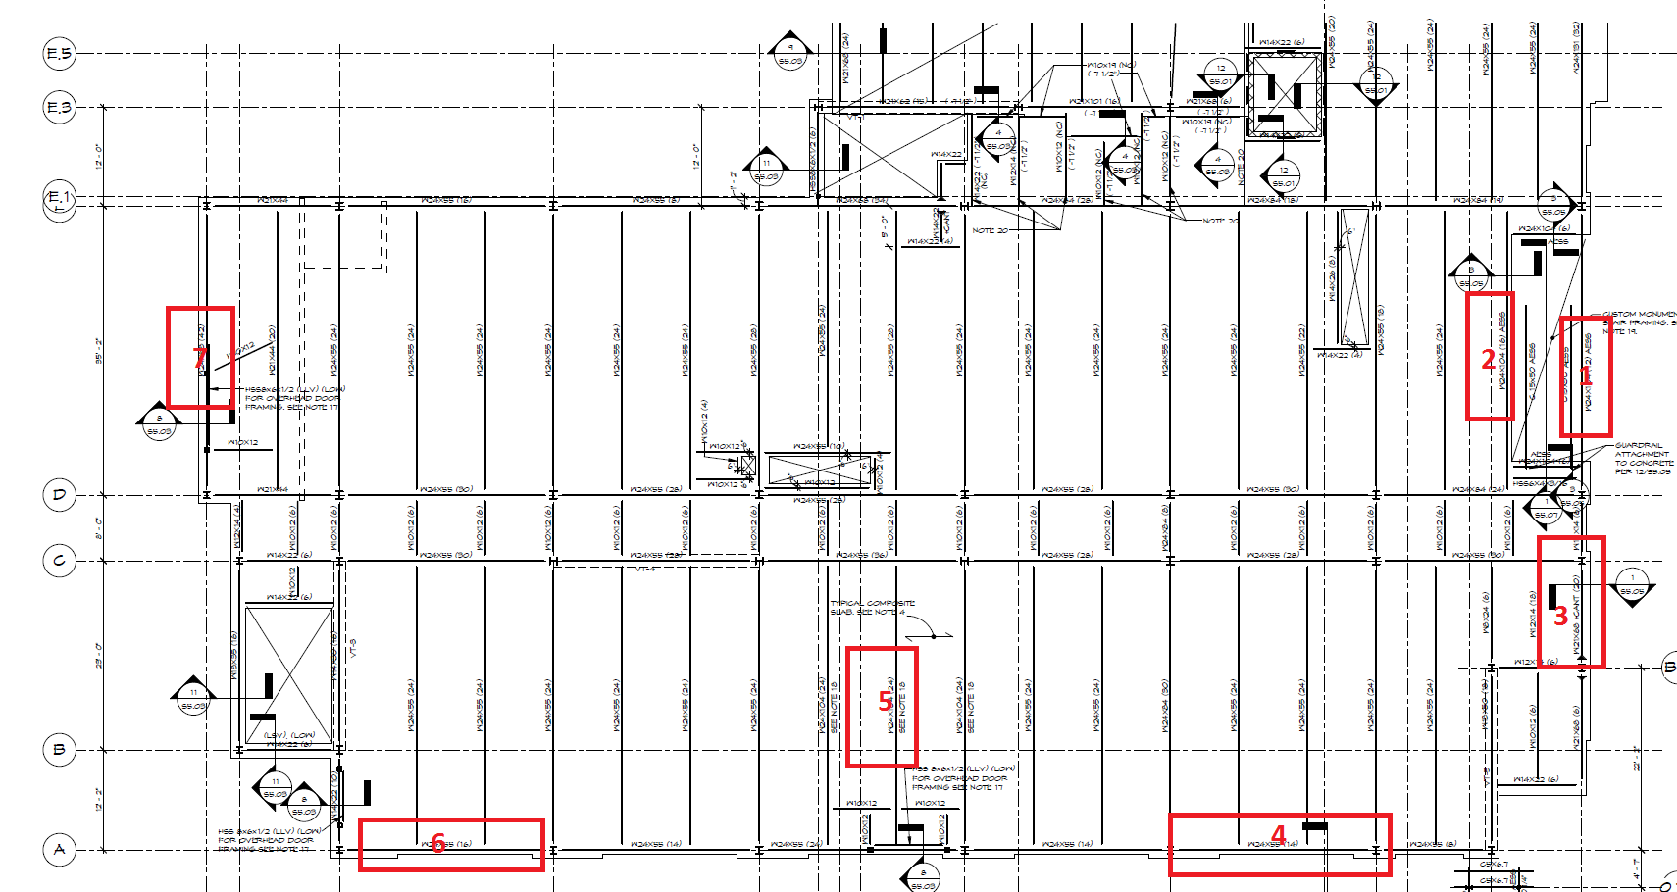
Analysis 3: Structural Steel Sequencing
The Educational Activities Building
Penn State Harrisburg | Middletown, PA
Meshal Alenezi | Construction Management
Presentation Outline:
Project Overview
Analysis 1: Green Roof System
Analysis 2: MEP Systems Prefabrication
Analysis 3: Structural Steel Sequencing
  Current Steel Sequence
  Crane Selection
  Proposed Steel Sequence
  Results
Analysis 4: Technology Integration For Information Management
Conclusion & Recommendations
Acknowledgment
Questions
Beam # | Beam Size | Beam Length (ft) | Beam Weight (lb) | Distance from Crane | Safety Check
Beam 1 | W24x104 | 35.17 | 3,657 | 75 | Passes
Beam 2 | W24x104 | 35.17 | 3,657 | 70 | Passes
Beam 3 | W21x68 | 22.17 | 1,507 | 85 | Passes
Beam 4 | W24x55 | 25 | 1,375 | 90 | Passes
Beam 5 | W24x104 | 35.17 | 3,657 | 75 | Passes
Beam 6 | W24x55 | 26’ | 1,730 | 85 | Passes
Beam 7 | W24x68 | 35.17 | 2,391 | 75 | Passes
The Critical Beams Location of the South Wing

Slide 16
Analysis 3: Structural Steel Sequencing
The Educational Activities Building
Penn State Harrisburg | Middletown, PA
Meshal Alenezi | Construction Management
Presentation Outline:
Project Overview
Analysis 1: Green Roof System
Analysis 2: MEP Systems Prefabrication
Analysis 3: Structural Steel Sequencing
  Current Steel Sequence
  Crane Selection
  Proposed Steel Sequence
  Results
Analysis 4: Technology Integration For Information Management
Conclusion & Recommendations
Acknowledgment
Questions
Criteria | Original Steel Sequence | Proposed Steel Sequence
Crane Size | 30 Ton, 90’ Boom, 43’ Jib | 50 Ton, 110’ Boom, 32’ Jib
# of Crane Locations | 4 | 1
Duration (Days) | 26 | 18
Steel Deliveries Phases | 4 | 3
Steel Laydown | Within 30’ from the crane | Within 30’ from the crane
Sequence Direction | S Wing to the N Wing | N Wing to the S Wing
Comparison Between the Original and Proposed Steel Sequence
 | Daily Cost ($/Day) | Schedule Reduction (Days) | Total Savings ($)
Structural Labor | 239.5 | 8 | 1,916
Crane/Crane Operator | 389.4 | 8 | 3115.2
General Conditions | 3,176.54 | 8 | 25,412.32
Total |  |  | 30,527.52
The Proposed Site Plan and Crane Location
The Cost Savings & Schedule Reduction
Notes:
The crane will be located right outside the building parameter, north of the south wing and west of the north wing.
This location is ideal because the crane radius covers the entire project floor area and the project team would not have to change the location of the crane several times.
The steel laydown area will be located to the west of the building, within reach from the crane to ensure an efficient and faster steel erection.
the sequence will start from the north wing to the south wing. That’s because the north wing consists of 1 level and once it’s done other trades can start their tasks.

Slide 17
Analysis 3: Structural Steel Sequencing
The Educational Activities Building
Penn State Harrisburg | Middletown, PA
Meshal Alenezi | Construction Management
Presentation Outline:
Project Overview
Analysis 1: Green Roof System
Analysis 2: MEP Systems Prefabrication
Analysis 3: Structural Steel Sequencing
  Current Steel Sequence
  Crane Selection
  Proposed Steel Sequence
  Results
Analysis 4: Technology Integration For Information Management
Conclusion & Recommendations
Acknowledgment
Questions
Cons
Bigger and More Expensive Crane
Recommendation
Due to the cost savings of $30,527.52
and 8 Days schedule Reduction, the implementation of the solution is recommended.
Pros
Schedule Reduced by 8 Days
$5,031.2 Labor Cost Savings
$25,412.32 General Conditions Savings
Notes:
First Street is the only main road adjacent to the Site on the East.
Minimize the number of crane locations
Located the material laydown area within the crane reach at all time
3 deliveries to avoid any delays

Slide 18
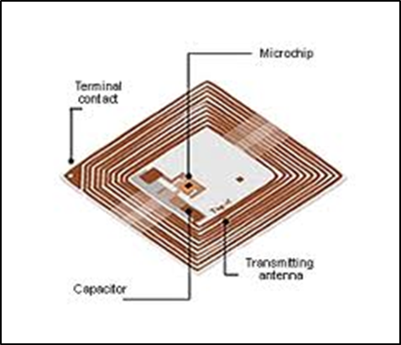
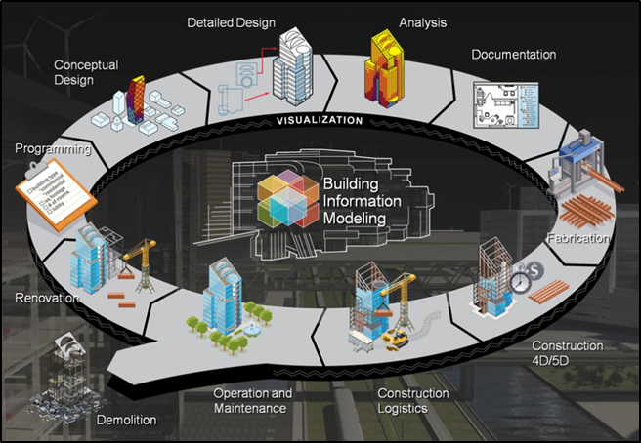

Analysis 4: Technology Integration For Information Management
The Educational Activities Building
Penn State Harrisburg | Middletown, PA
Meshal Alenezi | Construction Management
Presentation Outline:
Project Overview
Analysis 1: Green Roof System
Analysis 2: MEP Systems Prefabrication
Analysis 3: Structural Steel Sequencing
Analysis 4: Technology Integration For Information Management
  Preliminary Analysis
  Proposed Strategy
  Results
Conclusion & Recommendations
Acknowledgment
Questions
Opportunity Identification
22nd annual PACE Roundtable introduced the use of technology for Information Management.
Technology Implemented on the Project
BIM Uses
  Different Project Phases: Planning, Design, Construction and Turnover.
  Coordination & Modeling
  Clash Detection
  Asset Management
Electronic Documents
Technology Tools Used in the Construction Industry
Tablets are becoming popular tools to view project documents and exchange information on site.
“Proper use of technology will also reduce change orders and cost of construction.” Mr. Adam Dent, Project Manager.
RFID Tags are used to keep track of materials.
BIM Uses
Notes:
BIM could be used as a tool for document management where the project team can share information and documents between each other. Architects, engineers or contractors can update the construction progress or request information through BIM.
BIM can be used to plan maintenance activities, track maintenance record and increase the maintenance productivity for the project systems over its operational life. This will help to improve the performance of the facility, avoid emergency repairs and reduce the overall cost of maintenance.
To be integrated into PSU’s facility management system. The Educational Activities Building contains class rooms and laboratories which makes this specific BIM use a great help to manage the space in case of any changes in the building functionality.

Slide 19
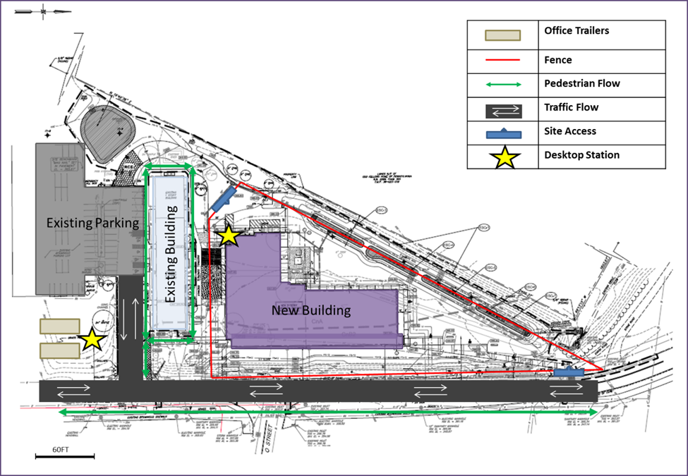
Analysis 4: Technology Integration For Information Management
The Educational Activities Building
Penn State Harrisburg | Middletown, PA
Meshal Alenezi | Construction Management
Presentation Outline:
Project Overview
Analysis 1: Green Roof System
Analysis 2: MEP Systems Prefabrication
Analysis 3: Structural Steel Sequencing
Analysis 4: Technology Integration For Information Management
  Preliminary Analysis
  Proposed Strategy
  Results
Conclusion & Recommendations
Acknowledgment
Questions
Two Desktop Stations
18 FieldLens Memberships
6 Tablets
BIM
  “Document Management”
  “Building Maintenance Scheduling”
Item | Quantity (Hours per week) | Cost ($) /Unit (Hour) | Total Cost Savings ($) Per Week
Penn state Project Manager | 5 | 95 | 475
Penn state BIM Manager | 5 | 65 | 325
Reynolds Construction BIM Manager | 5 | 65 | 325
Reynolds Construction Project Executive | 5 | 103 | 515
Reynolds Construction Project Manager | 5 | 95 | 475
Reynolds Construction On-Site Construction Manager | 5 | 90 | 450
IT Technician | 5 | 70 | -350
Total |  |  | 2,215
Item | Quantity | Cost $/Unit | Total Cost $
Generic Tablets | 6 | 4,00 | 2,400
FieldLens Membership | 18 | 20 (per month for 16 months) | 5,760
Desktops | 2 | 6,00 | 1,200
Desktop Stations | 2 | 65 | 130
Utility Cost |  |  | 104
Total |  |  | 10,594
Site Plan and Desktop Station Locations
The Cost of Implementation
The Cost Savings
Notes:
The two desktop stations will be placed in two different locations of the project; one located right outside of the office trailers and one is located in the South West of the building.
The desktop stations will be made of a computer cabinet ($65 each) with a lock to protect it from the weather elements and theft.
the Facebook of the construction industry. Its main purpose is to make communication between the project team as accessible and effortless as possible. The project team can use it to issue jobsite tasks, track field progress and organize project document in one place. It is accessible by tablets, computers and phones. Every member of the project team can use it, including the owner, general contractor, designers, subcontractors, engineers, etc. . The website is very secure and user friendly, no training is required and can be used with minimum technology practice.
In addition, BIM “Document Management” feature will be considered which will not require much work due to the heavy use of BIM on the Educational Activities Building project.
Also, the “Building Maintenance Scheduling” feature will be implemented on this project.
The utility cost was estimated based on the average annual electricity consumption, the next assumptions were made
Each tablet is charged once daily
Each desktop is used for 9 hours everyday
All devices will be used for approximately 1.5 years which is the duration of the project
Savings were calculated by using the data found through the in-depth research and case studies as well as general conditions information from technical assignment 2.
The return on investment is projected to start on the fifth week of the construction.
Total Savings $141,760

Slide 20
Analysis 4: Technology Integration For Information Management
The Educational Activities Building
Penn State Harrisburg | Middletown, PA
Meshal Alenezi | Construction Management
Presentation Outline:
Project Overview
Analysis 1: Green Roof System
Analysis 2: MEP Systems Prefabrication
Analysis 3: Structural Steel Sequencing
Analysis 4: Technology Integration For Information Management
  Preliminary Analysis
  Proposed Strategy
  Results
Conclusion & Recommendations
Acknowledgment
Questions
Pros
Improved Communication and Documents Sharing
$2,215/Week General Conditions Savings
Recommendation
Due to the cost savings of $141,760 over the entire project duration, the implementation of the solution is recommended.

Slide 21
The Educational Activities Building
Penn State Harrisburg | Middletown, PA
Conclusion & Recommendations
Meshal Alenezi | Construction Management
Presentation Outline:
Project Overview
Analysis 1: Green Roof System
Analysis 2: MEP Systems Prefabrication
Analysis 3: Structural Steel Sequencing
Analysis 4: Technology Integration For Information Management
Conclusion & Recommendations
Acknowledgment
Questions
Analysis1: Green Roof System:
High Initial Cost, $181,120
4 Days Installation Process
Analysis2: MEP Systems Prefabrication
Less Site Congestion
Schedule Reduced by 41 Days
$328,837.32 Labor Cost Savings
$130,238.14 General Conditions Savings
Analysis3: Structural Steel Sequencing
Schedule Reduced by 8 Days
$5,031.2 Labor Cost Savings
$25,412.32 General Conditions Savings
Analysis4: Technology Integration for Information Management:
Improved Communication and Documents Sharing
$2,215/Week General Conditions Savings
Recommendation
Due to the initial high cost and low ROI, implementing this solution is not recommended.
Recommendation
Due to the cost savings of $459075.46 and 41 Days schedule Reduction, the implementation of the solution is recommended.
Recommendation
Due to the cost savings of $30,527.52
and 8 Days schedule Reduction, the implementation of the solution is recommended.
Recommendation
Due to the cost savings of $141,760 over the entire project duration, the implementation of the solution is recommended.

Slide 22
The Educational Activities Building
Penn State Harrisburg | Middletown, PA
Acknowledgment
Meshal Alenezi | Construction Management
Presentation Outline:
Project Overview
Analysis 1: Green Roof System
Analysis 2: MEP Systems Prefabrication
Analysis 3: Structural Steel Sequencing
Analysis 4: Technology Integration For Information Management
Conclusion & Recommendations
Acknowledgment
Questions
Special Thanks
My Family and Friends
Mr. Adam Dent
Mr. Tim Sullivan
Ms. Natalie Gentile
Mr. Brian Shaffer
PACE Industry Members
Academic
Dr. Craig Dubler
Dr. Moses Ling
Dr. Kevin Parfitt
Dr. John Messner
Industry
Reynolds Construction
BCJ Architecture
Penn State OPP

Slide 23

The Educational Activities Building
Penn State Harrisburg | Middletown, PA
Questions
Meshal Alenezi | Construction Management
Presentation Outline:
Project Overview
Analysis 1: Green Roof System
Analysis 2: MEP Systems Prefabrication
Analysis 3: Structural Steel Sequencing
Analysis 4: Technology Integration For Information Management
Conclusion & Recommendations
Acknowledgment
Questions

